Slide 1


Analyzing Production Scenarios through Simulation Models: A Comprehensive Study
By Mateusz Kikolski
Prepared By : Moinul Hossain Bhuiyan 20301002 Brac University

Slide 2
What We Will Learn
Analyzing Production Scenarios through Simulation Models: A Comprehensive Study

Slide 3
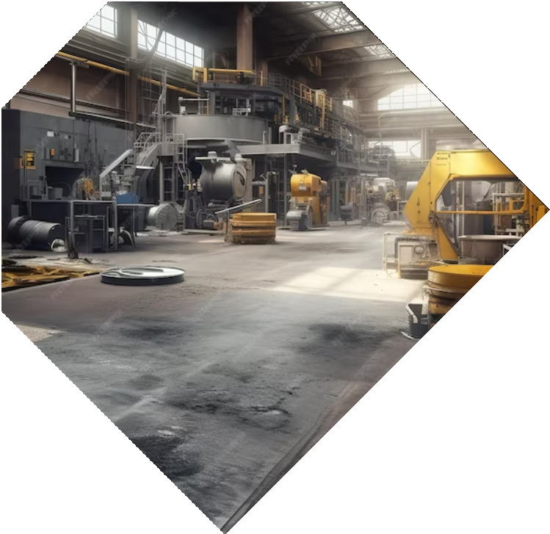
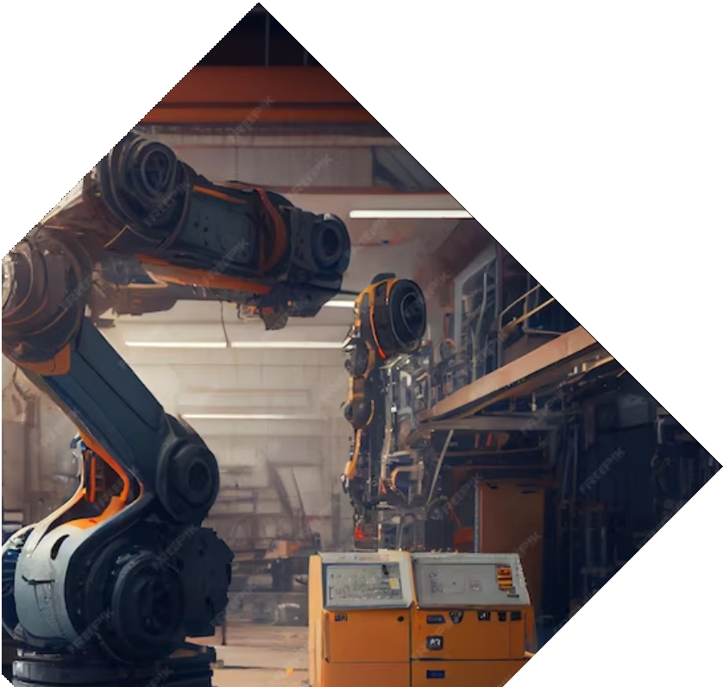
Introduction
A computer simulation, as a method, is a system of research activities, i.e. a structure of stage activities aimed at achieving a research objective. These are the following activities:
creating a mathematical model
formulating a programme for a computer
checking the appropriateness of the model
planning simulation experiments
performing a simulation process and analysing the results.

Slide 4


Objective
To analyze various production scenarios using simulation models and provide a comprehensive study of their effectiveness. This study aims to identify optimal production strategies and improve decision-making processes in
manufacturing.

Slide 5
Objective
With a view to the objective of the simulation, it can be divided into three types :
a simulation aimed at understanding the principles of the functioning of the system and its properties that are difficult to distinguish on the basis of a formal analysis
a simulation aimed at facilitating decision making within the functioning of the system
a simulation, whose aim is to train people within decision making concerning the functioning of the system.

Slide 6


Simulation Models
: These models replicate real-world production scenarios in a virtual environment, allowing us to assess their performance and identify potential bottlenecks or inefﬁciencies. By simulating different scenarios, we can optimize production processes and
minimize risks.

Slide 7
Simulation models in production engineering
Contemporary production involves a wide range of products, reduced life cycles, and reduced costs. Simulation studies help in real-time data collection and planning. Implementing computer solutions in production engineering reduces costs and time, and aids in effective selection of manufacturing strategies.
Simulation, as each method, has its pros and cons. Benefits of a simulation:
a simulation allows for arranging a form of a system with the use of experiments directly conducted on the studied model it may be applied for analysing large and complex decisional problems that cannot be solved with the use of other methods
it allows for quick preparation of decisions thanks to analysing the effects of experiments conducted for many alternating periods
it provides an answer to the “what-if...?” questions – simulation experiments allow for analysing various decisional alternatives
it allows for analysing correlations of the effects of variable elements of a model that can influence the decision chosen in extreme conditions.
However, drawbacks include long preparation time, uniqueness of models, inability to analyze other issues, and need to account for specific and changeable conditions.

Slide 8
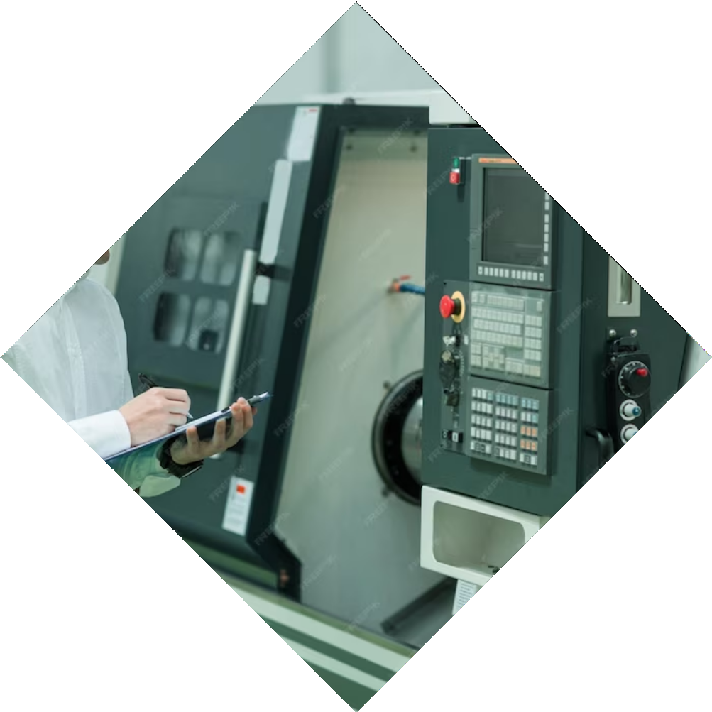
Possibilities for applying Plant Simulation
Siemens' Tecnomatix Plant Simulation is a tool for creating simulation models, combining technological areas, production engineering, and logistics, from planning to manufacturing, ensuring sustainable production and process optimization.
With Plant Simulation enterprises are able to perform tests and experiments according to selected scenarios and swiftly specify the best strategies aimed at significant intensification of efficacy, cost reduction, time-saving, as well as achieving quality targets. Such procedure makes the need to perform tests within the production hall redundant.

Slide 9


Analysis and Optimization
Simulation models enable us to analyze the collected data and identify areas of improvement. By optimizing production scenarios, we can enhance productivity, reduce costs, and minimize risks.

Slide 10



Case Studies
Real-world case studies needs to be conducted to validate the effectiveness of the simulation models. These studies will provide practical insights into different production scenarios and their outcomes.

Slide 11
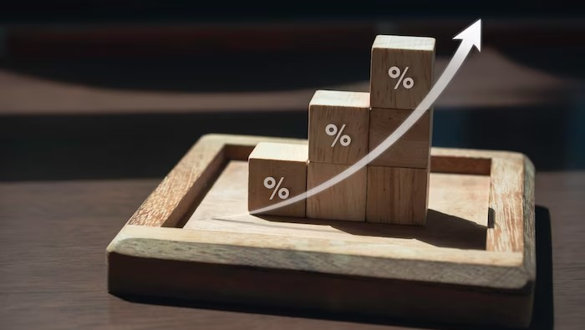

Benefits
The comprehensive study of production scenarios through simulation models offers several advantages, including improved decision-making, reduced risks, enhanced productivity, optimized resource allocation, and
increased proﬁtability.

Slide 12

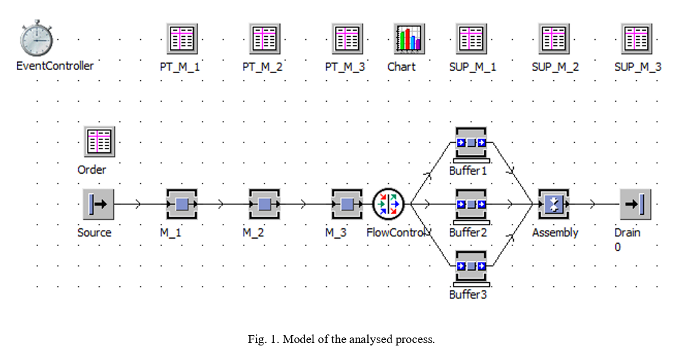
The analysed production scenarios
The model of a production system is based on an example of a real production department, with the use of Tecnomatix Plant Simulation software (Fig. 1). The input data are determined on the basis of the known technological data of the process and the data concerning material flow during production. It is particularly essential to reflect activities connected with the processing of individual components. The conducted experiments entailed studying to what extent the change in the size of the batches of entered components influences the efficiency of the system.

Slide 13
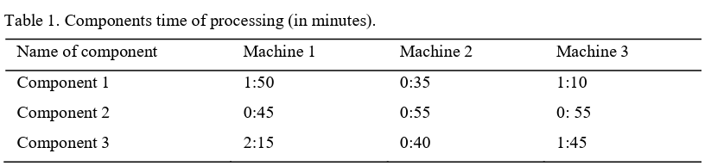
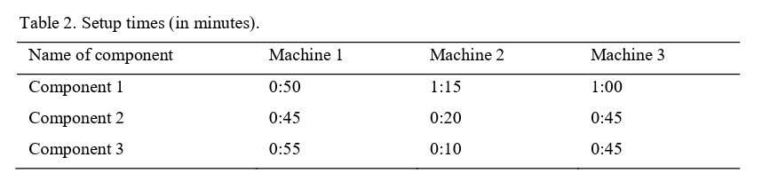
The analysed production scenarios contd.
Table 1 presents unit timing of processing at specific stations. Assembly timing is constant and equals
The timings of retooling the stations in a studied process are included in Table 2.
They denote the time needed to change the basic parameters of a machine,
lapsing from the last element of one type to the first element of the other type.
The level of machine availability is constant for all scenarios. It equals respectively
95% for machine 1, 90% for machines 2 and 3, and 80% for Assembly Station. The simulation period assumed one 8-hour shift.

Slide 14
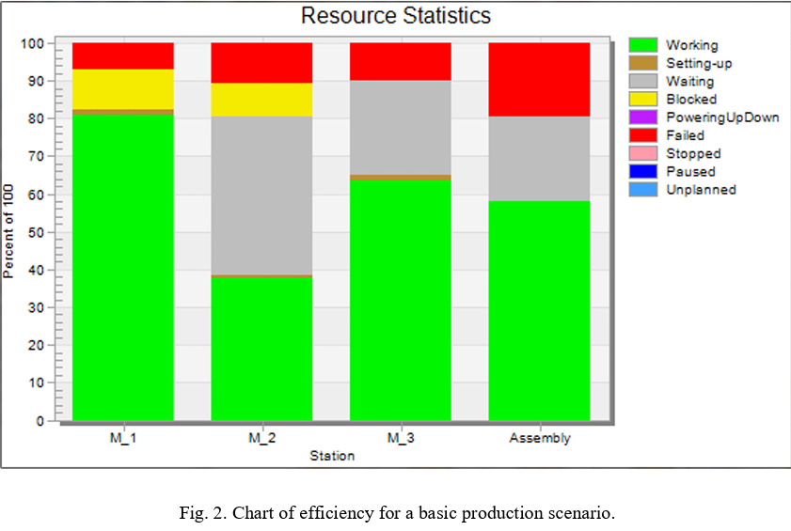
The analysed production scenarios contd.
Scenario 1 :
The analysis primarily focused on the scenario currently conducted in the enterprise. It assumes entering series of 30 items of each component into the system. The result of the simulation was 63 manufactured final products. Figure 2 presents a chart of efficiency for a basic production scenario.

Slide 15
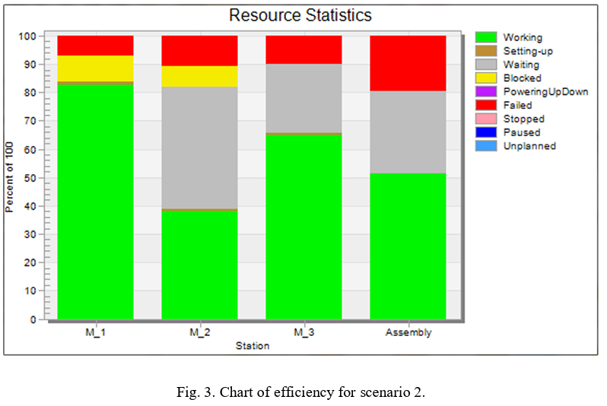
The analysed production scenarios contd.
Scenario 2 :
Subsequently, the production system underwent an analysis, where the batch was increased up to 45 items of each element. This change led to the reduction of the production down to 56 items within 8 hours of simulation.
Apart from reducing the number of manufactured final products, there also exist changes in the efficiency of work stations. The work load of machine 1 dropped increased from 80,78% to 82,33%, as to machine 2 - it increased from 37,57% to 38,13%, and for machine 3 it increased from 63,38% to 64,84%, as referred to the basic process. Due to a longer waiting time for all components, the timing of using the assembly station fell from 58.13% to 51.55%.

Slide 16
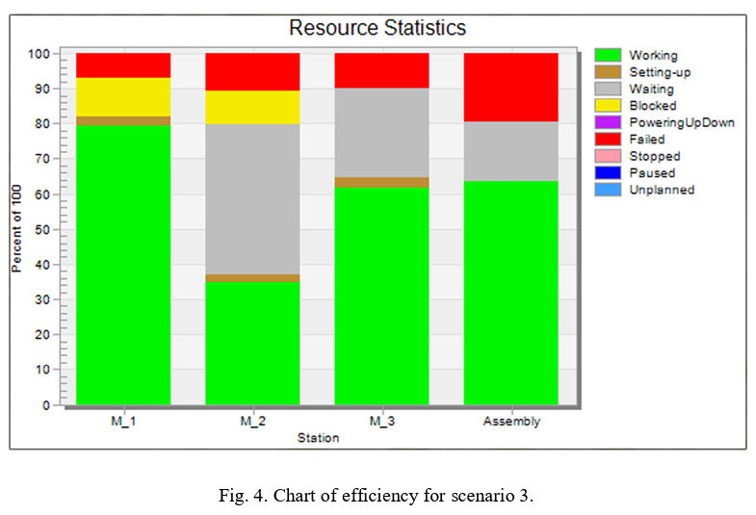
The analysed production scenarios contd.
Scenario 3 :
The third scenario assumes the reduction of volumes of entered batches down to 15 items. This resulted in the increase in the total production of the analysed process from 63 to 69 items of final products, preserving constant parameters of all objects of the model.

Slide 17
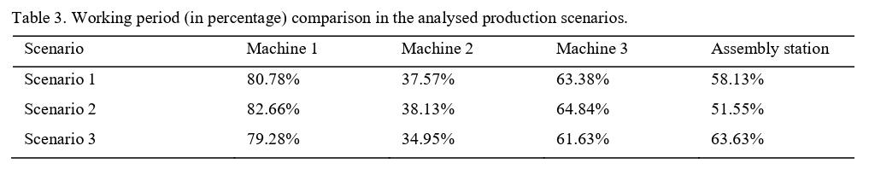
The analysed production scenarios contd.
The gathered statistics were compared to the basic process (scenario 1). As the chart shows, despite increased total production at the time of simulation, the work load dropped in all machines. Thanks to more frequent provision with necessary semi-products, the efficiency of the assembly station increased. This has a direct impact on the increase in total production. The total time of retooling grew at all stations, which was caused by frequent changes of processed elements.
Table 3 presents the comparison of basic statistics achieved in the analysed production scenarios.

Slide 18

The analysed production scenarios contd.
This leads to the conclusion that reducing the batches entered into the system may increase its efficiency and flow of the transfers. However, it should be emphasized that the research involved three exemplary scenarios. The research within a wider scope could help in determining optimal volumes of production batches.

Slide 19

Future Research
Further studies can explore advanced simulation techniques, integration with emerging technologies like artiﬁcial intelligence, and the application of simulation models in different industries to expand the scope of production
scenario analysis.

Slide 20
Conclusion
Analyzing production scenarios through simulation models provides valuable insights for optimizing production processes, reducing risks, and improving decision-making. This comprehensive study highlights the beneﬁts and limitations of simulation models and suggests avenues for future research.

Slide 21
Conclusion
The study investigated production scenarios using simulation models in a Tecnomatix Plant Simulation system. Results showed the highest efficiency was achieved with 15-item batches, while increasing components lowered efficiency. Simulation models help verify processes and visualize assumptions, but managers should still make decisions. Computer simulations can be a reliable tool for manufacturing processes.

Slide 22
Thanks!
Do you have any questions?
moinul.hossain.bhuiyan@g.bracu.ac.bd

